Slide 1
Name: Break and Say
Category> Articulation

Slide 2
Select the target goal
p sound
l sound
z sound
b sound
n sound
m sound
r sound
ch sound
s sound
d sound
sh sound
f sound
t sound
g sound
th sound
h sound
v sound
j sound
w sound
k sound
y sound

Slide 3
Apply to all
p sound
Initial
10 images per category (420/840)
Medial
Final
Sentence

Slide 4
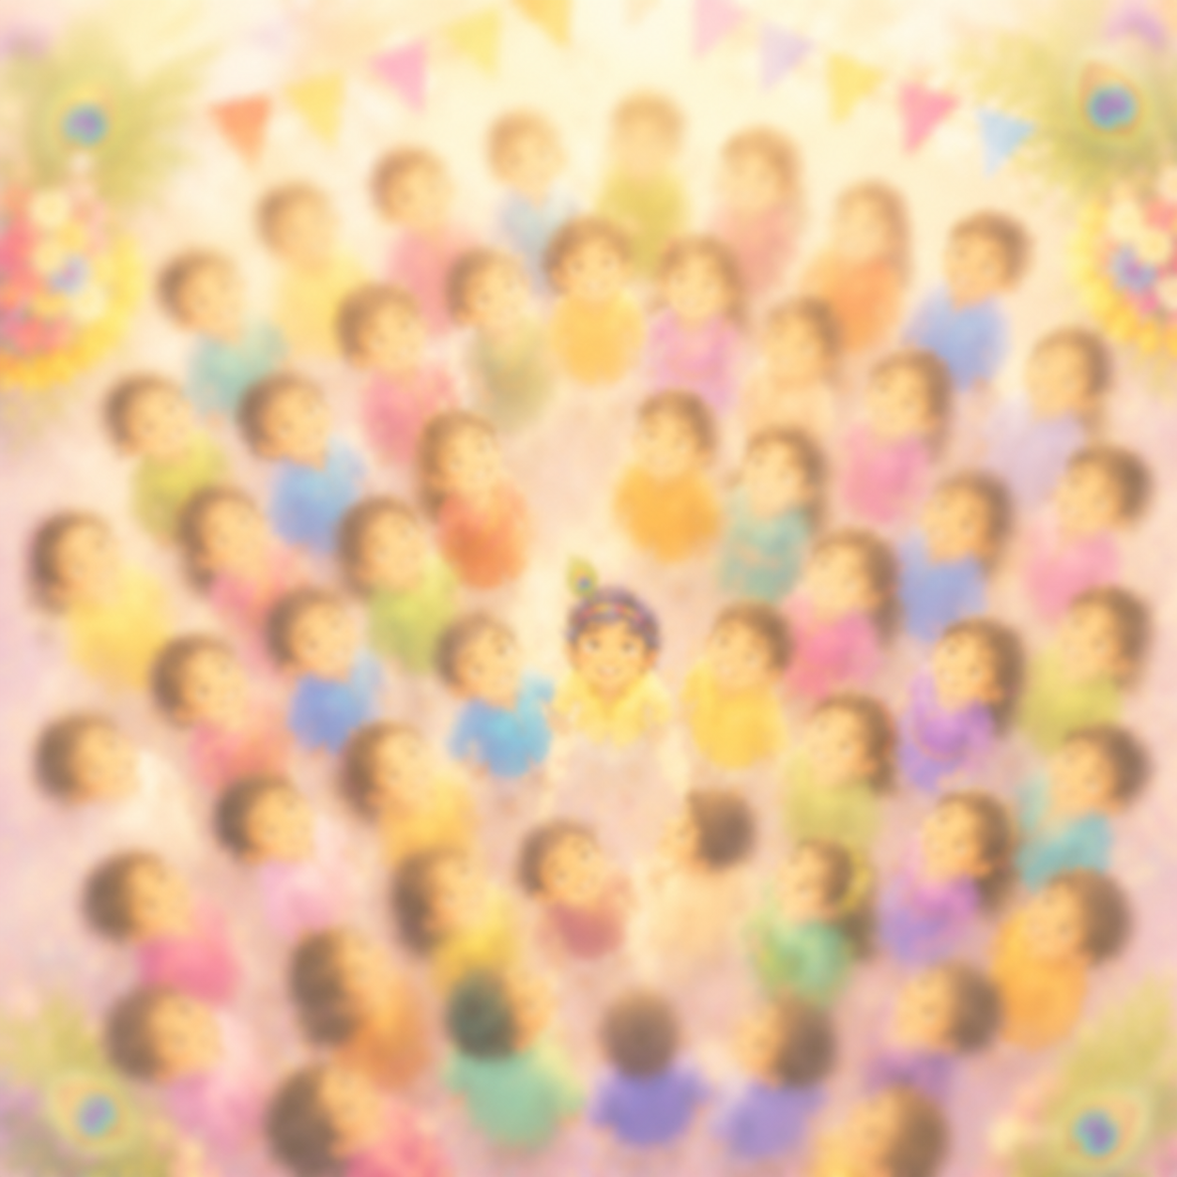
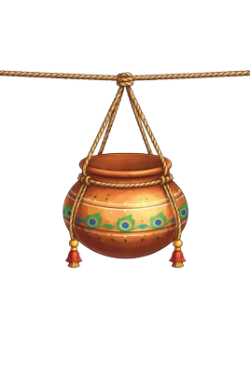

Slide 5
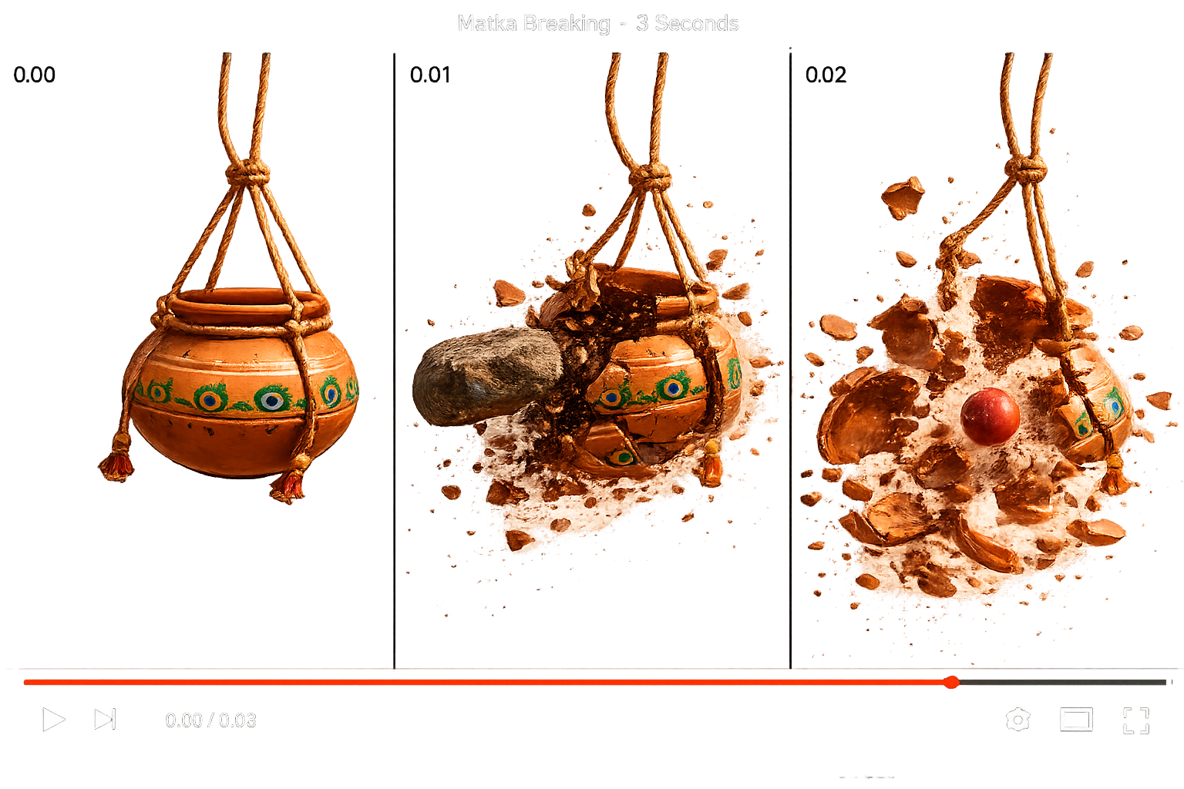

Slide 6
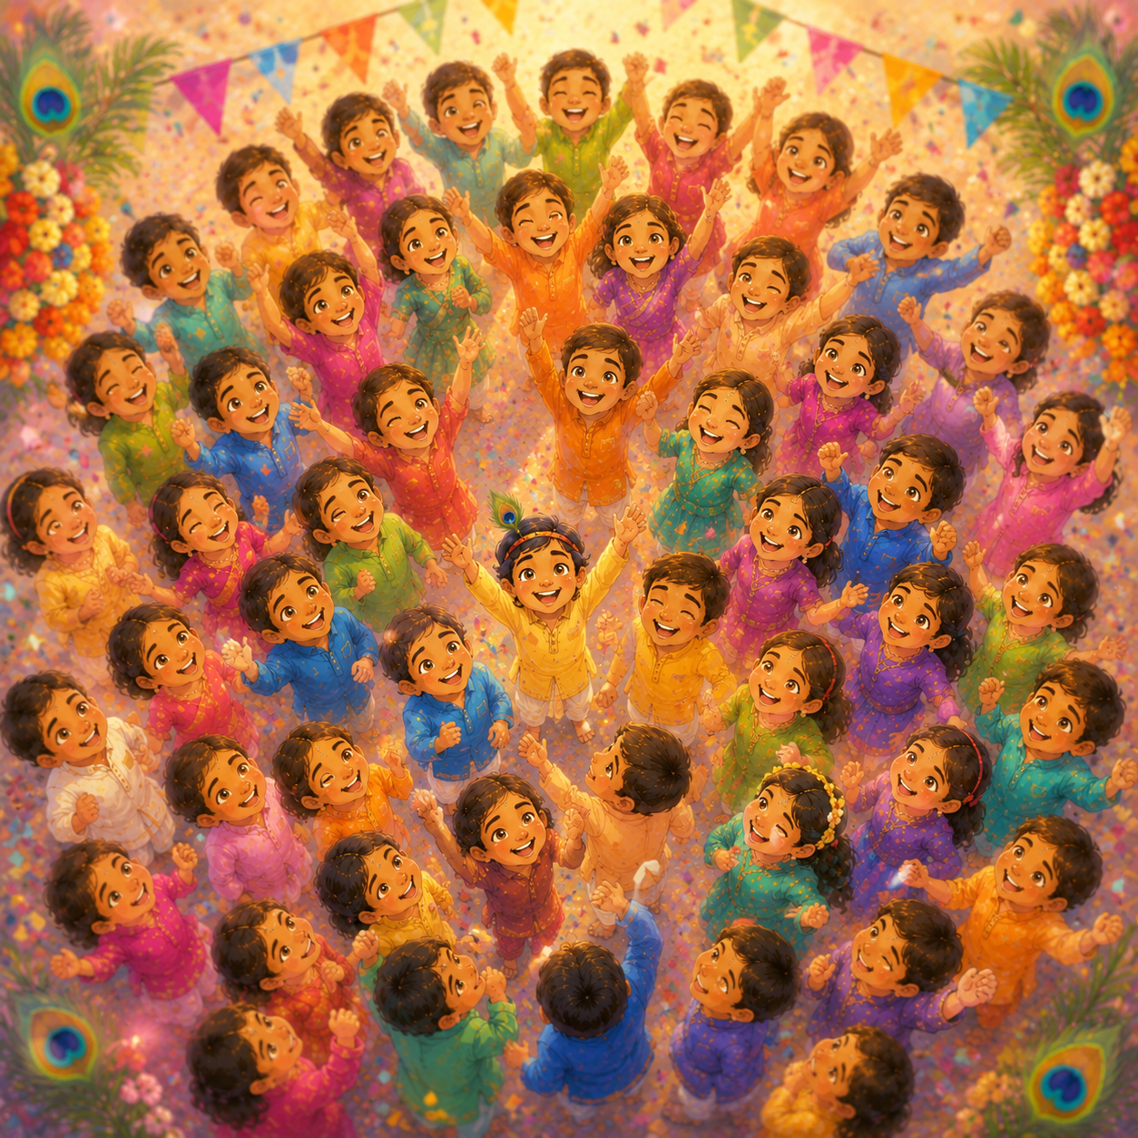

Slide 7
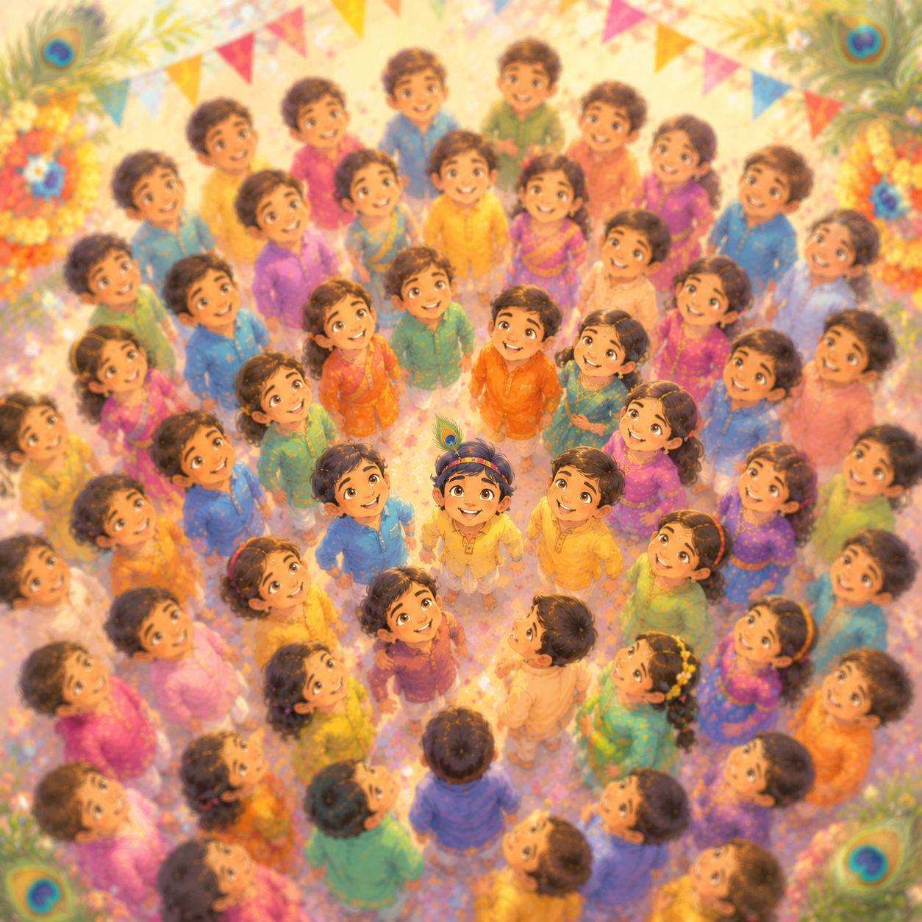

Slide 8
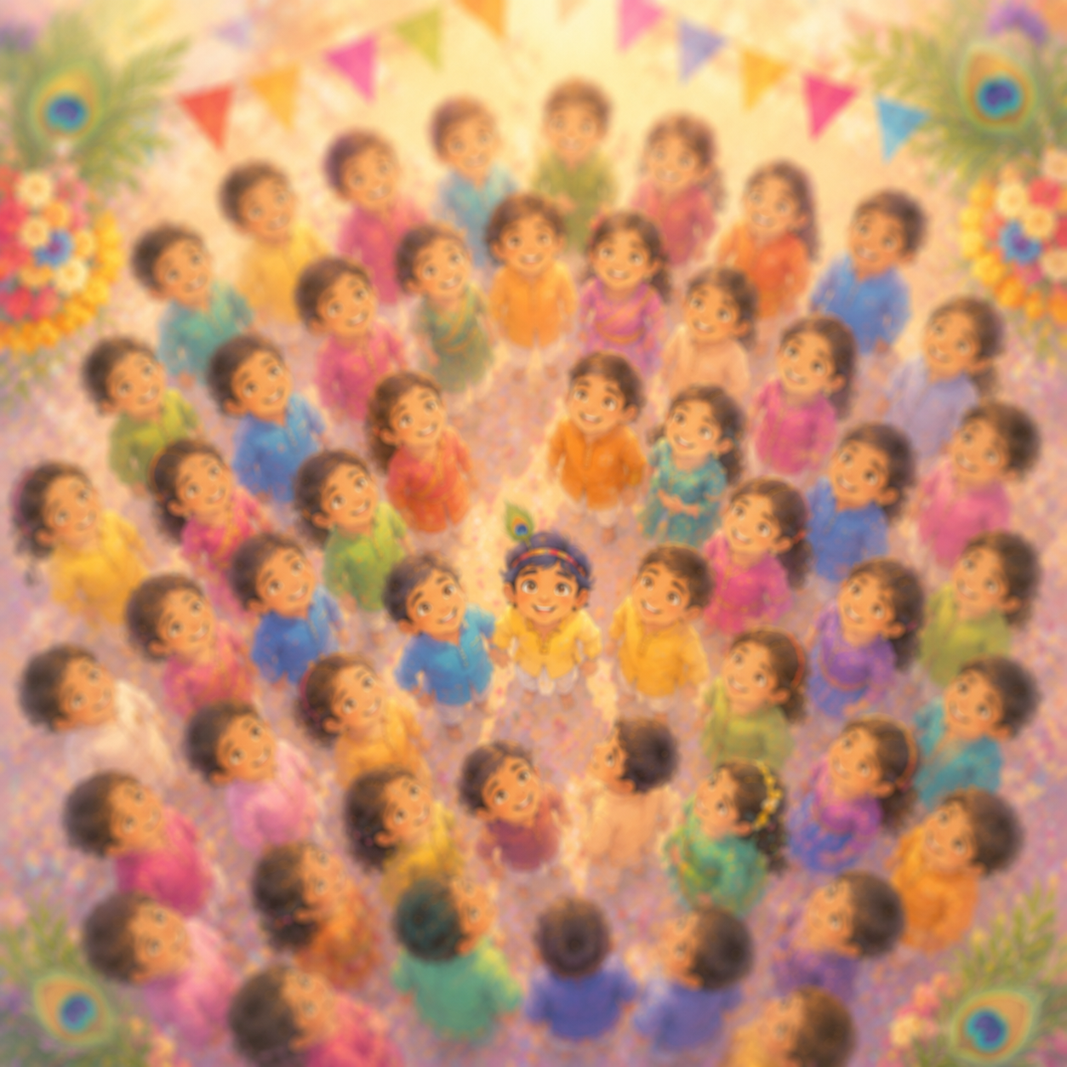

Slide 9
p sound

Slide 10
Pig
https://www.magnific.com/free-vector/cute-pig-with-pink-skin-white_6952407.htm#fromView=search&page=1&position=0&uuid=bb902d0a-86b3-4c88-a6fe-7e4dfbbfd2f5&query=pig

Slide 11
Pan
https://www.magnific.com/premium-photo/black-frying-pan-wok-white-background-simplicity_274194495.htm#fromView=search&page=1&position=6&uuid=15d4bb9c-9a6e-487a-a641-21bb7bcbe985&query=pan

Slide 12
Pen
https://www.magnific.com/free-vector/vector-fountain-writing-pen-contract-signing_10601400.htm#fromView=search&page=1&position=0&uuid=d671e2ee-3a7d-4cfb-a7fa-421615c6c381&query=pen

Slide 13
Pizza
https://www.magnific.com/free-vector/colorful-round-tasty-pizza_3799722.htm#fromView=search&page=1&position=13&uuid=62b95b75-0820-487e-bd16-044e479a524d&query=pizza

Slide 14
Pencil
https://www.magnific.com/premium-vector/yellow-pencil-flat-icon-lead-pencil-with-eraser_19874872.htm#fromView=search&page=1&position=8&uuid=cfabe67b-18dd-4bf3-a9d4-e5bd0aad1999&query=pencil

Slide 15
Popcorn
https://www.magnific.com/premium-vector/popcorn-corn-movie-vector-snack-food-entertainment-cinema-pop-film-illustration-box-cont_85105768.htm#fromView=search&page=1&position=33&uuid=67aebb84-c893-4c0b-acef-ca0e370f3d42&query=popcorn

Slide 16
Pumpkin
https://www.magnific.com/premium-vector/pumpkin-vegetable-cooking-meals-bright-element-isolated-white-design_321537786.htm#fromView=search&page=1&position=11&uuid=74cf75bc-d058-4ce0-9552-793a2f6bac6d&query=pumpkin

Slide 17
Puppy
https://www.magnific.com/free-psd/adorable-beagle-puppy-solo-portrait_3730322.htm#fromView=search&page=1&position=7&uuid=a83acc37-58b5-4b79-b246-d042203a41e8&query=puppy

Slide 18
Paper
https://www.magnific.com/free-vector/brochure-design-template-mockup-vector_3756049.htm#fromView=search&page=1&position=2&uuid=946a3409-60f9-41fe-9e75-67f0a52033c2&query=page

Slide 19
Penguin
https://www.magnific.com/premium-vector/penguin-vector-art-illustration-19_201589107.htm#fromView=search&page=1&position=7&uuid=a44f7180-91bd-498d-a9dc-15578788ae49&query=penguin

Slide 20
Apple
https://www.magnific.com/free-psd/fresh-red-apple-with-single-green-leaf-stem-sits-isolated-against-solid-black-background_424644489.htm#fromView=search&page=1&position=1&uuid=1e44eab9-744d-47c1-904f-9f3e6885713a&query=apple

Slide 21
Happy
https://www.magnific.com/premium-vector/happy-cartoon-boy-jumping-smiling_418519722.htm#fromView=search&page=1&position=6&uuid=13703159-4eb0-4bda-a7c8-c5514c1ab668&query=happy

Slide 22
Puppy
https://www.magnific.com/free-psd/adorable-beagle-puppy-solo-portrait_3730322.htm#fromView=search&page=1&position=7&uuid=c2afb8bc-c7aa-4a06-ba76-e532d69aeae4&query=puppy

Slide 23
Paper
https://www.magnific.com/premium-psd/blank-lined-notebook-paper-with-torn-edge-punch-holes_422656478.htm#fromView=search&page=1&position=6&uuid=4b82fb14-4ade-4a68-af30-3245eb10637a&query=paper

Slide 24
Open
https://www.magnific.com/premium-photo/open-cardboard-box-delivery-isolated-white-background-3d-render_12803328.htm#fromView=search&page=1&position=5&uuid=f59ebd5d-5229-4229-ac6f-479d8a336c01&query=open+box

Slide 25
Napkin
https://www.magnific.com/premium-photo/folded-checkered-napkin-isolated-white-top-view_37390730.htm#fromView=search&page=1&position=20&uuid=fd937e79-61ca-4ebd-92a2-cccd18cd4953&query=napkin

Slide 26
Zipper
https://www.magnific.com/premium-vector/zipper-silhouette-clipart-vector-flat-design-black-white-zipper-white-background_72169384.htm#fromView=search&page=1&position=7&uuid=952e02a8-a0f5-403a-9b5c-7da7b0a57b18&query=zipper

Slide 27
Cupcake
https://www.magnific.com/free-psd/delightful-pink-cupcake-with-rainbow-sprinkles_406619225.htm#fromView=search&page=1&position=0&uuid=23d1de65-aab9-428b-a1fc-b1a0057c0562&query=cupcake

Slide 28
Pepper
https://www.magnific.com/free-psd/whole-black-peppercorns-pile_426589593.htm#fromView=search&page=1&position=37&uuid=c5a572c5-db5d-4299-a417-ed76adff844f&query=pepper

Slide 29
Hippo
https://www.magnific.com/free-vector/hippopotamus-isolated-white-background_23723685.htm#fromView=search&page=1&position=4&uuid=182c3af0-ca7a-4b77-a986-7498e441f0c8&query=hippo

Slide 30
Cup
https://www.magnific.com/free-vector/coffee-cup-saucer_169537919.htm#fromView=search&page=1&position=4&uuid=e9f5d45f-45d0-4093-89be-93e6fe3f5da5&query=cup

Slide 31
Cap
https://www.magnific.com/premium-vector/red-baseball-cap-with-red-cap-it-vector-illustration_292966345.htm#fromView=search&page=1&position=5&uuid=a27a2c14-6678-41cc-bc0d-167062403f6b&query=cap

Slide 32
Soap
https://www.magnific.com/premium-photo/front-view-soap-bars-isolated-white-background_21131910.htm#fromView=search&page=1&position=8&uuid=925bdcf8-d609-459b-b11a-a1c1e9a26ef0&query=soap

Slide 33
Map
https://www.magnific.com/premium-vector/grey-india-map_31406205.htm#fromView=search&page=1&position=6&uuid=a10d8be2-f6bb-4999-a7aa-b2cb43f11bca&query=map+india

Slide 34
Tape
https://www.magnific.com/premium-vector/washi-tape-clipart-colorful-stationery-collage-element_187444274.htm#fromView=search&page=1&position=31&uuid=2e66fb94-a3f2-44e0-90aa-39af7220890c&query=tape

Slide 35
Grape
https://www.magnific.com/free-photo/delicious-bunch-grapes_976290.htm#fromView=search&page=1&position=0&uuid=7a479065-d8d4-4d3f-963a-add6d7317d61&query=grape

Slide 36
Lamp
https://www.magnific.com/premium-psd/elegant-wooden-table-lamp-with-beige-shade-warm-light-home-decor_411401589.htm#fromView=search&page=1&position=10&uuid=898142a7-7f3f-4707-b8b4-b44485f870de&query=lamp

Slide 37
Sheep
https://www.magnific.com/premium-vector/cartoon-sheep-white-background-vector_71611014.htm#fromView=search&page=1&position=25&uuid=4bac2eaf-7330-4a7b-8405-05dba773bee9&query=sheep

Slide 38
Mop
https://www.magnific.com/free-vector/broom-cleaning-equipment-utensil-icon_73262178.htm#fromView=search&page=1&position=0&uuid=729e2e43-4519-49ba-b03c-e554ac0cd6a4&query=mop

Slide 39
Soup
https://www.magnific.com/premium-vector/soup-bowl-meal-vector-food-dinner-vegetable-lunch-hot-illustration-plate-cooking-dish-r_86736357.htm#fromView=search&page=1&position=11&uuid=d9dca341-8011-4320-aed2-9d447df44b33&query=soup

Slide 40
The pig is pink.
https://www.magnific.com/free-vector/cute-pig-with-pink-skin-white_6952407.htm#fromView=search&page=1&position=0&uuid=bb902d0a-86b3-4c88-a6fe-7e4dfbbfd2f5&query=pig

Slide 41
Pop the popcorn.
https://www.magnific.com/premium-vector/popcorn-corn-movie-vector-snack-food-entertainment-cinema-pop-film-illustration-box-cont_85105768.htm#fromView=search&page=1&position=33&uuid=67aebb84-c893-4c0b-acef-ca0e370f3d42&query=popcorn

Slide 42
The puppy plays outside.
https://www.magnific.com/free-psd/adorable-beagle-puppy-solo-portrait_3730322.htm#fromView=search&page=1&position=7&uuid=c2afb8bc-c7aa-4a06-ba76-e532d69aeae4&query=puppy

Slide 43
Put the pen away.
https://www.magnific.com/free-vector/vector-fountain-writing-pen-contract-signing_10601400.htm#fromView=search&page=1&position=0&uuid=d671e2ee-3a7d-4cfb-a7fa-421615c6c381&query=pen

Slide 44
I see a purple penguin.
https://www.magnific.com/premium-vector/penguin-vector-art-illustration-19_201589107.htm#fromView=search&page=1&position=7&uuid=a44f7180-91bd-498d-a9dc-15578788ae49&query=penguin

Slide 45
The pizza is hot.
https://www.magnific.com/free-vector/colorful-round-tasty-pizza_3799722.htm#fromView=search&page=1&position=13&uuid=62b95b75-0820-487e-bd16-044e479a524d&query=pizza

Slide 46
The lamp is bright.
https://www.magnific.com/premium-psd/elegant-wooden-table-lamp-with-beige-shade-warm-light-home-decor_411401589.htm#fromView=search&page=1&position=10&uuid=898142a7-7f3f-4707-b8b4-b44485f870de&query=lamp

Slide 47
The sheep can jump.
https://www.magnific.com/premium-vector/cartoon-sheep-white-background-vector_71611014.htm#fromView=search&page=1&position=25&uuid=4bac2eaf-7330-4a7b-8405-05dba773bee9&query=sheep

Slide 48
Open the paper bag.
https://www.magnific.com/free-vector/brochure-design-template-mockup-vector_3756049.htm#fromView=search&page=1&position=2&uuid=946a3409-60f9-41fe-9e75-67f0a52033c2&query=page

Slide 49
The soap smells nice.
https://www.magnific.com/premium-photo/front-view-soap-bars-isolated-white-background_21131910.htm#fromView=search&page=1&position=8&uuid=925bdcf8-d609-459b-b11a-a1c1e9a26ef0&query=soap

Slide 50
b sound

Slide 51
Ball
https://www.magnific.com/premium-vector/beach-ball_34495426.htm#fromView=search&page=1&position=13&uuid=a2a6211c-53b2-461c-aa8a-219a741ab580&query=ball

Slide 52
Banana
https://www.magnific.com/free-psd/single-ripe-yellow-banana-with-green-stem-isolated-against-solid-black-background_424644514.htm#fromView=search&page=1&position=6&uuid=5e3f04cc-1921-4480-bf6b-3ce37a0dbcd4&query=banana

Slide 53
Book
https://www.magnific.com/premium-vector/book-vector_379176632.htm#fromView=search&page=1&position=17&uuid=ef247ff4-f97a-4eb5-a168-2568c2d94977&query=book

Slide 54
Bed
https://www.magnific.com/free-vector/bed-with-blue-pillow-sheet_2204447.htm#fromView=search&page=1&position=8&uuid=4568d0bc-7247-4b08-8d48-031e7cf1f352&query=bed

Slide 55
Bird
https://www.magnific.com/premium-vector/nature-illustration-bird-vector-background-black-silhouette-isolated-design-animal-white_74663130.htm#fromView=search&page=1&position=15&uuid=3bb09a04-841d-4735-b04a-956f9c0b0185&query=bird

Slide 56
Bag
https://www.magnific.com/free-vector/backpack-realistic-illustration_23128949.htm#fromView=search&page=1&position=9&uuid=8eba971b-dd30-4273-8b76-26c536dea055&query=bag

Slide 57
Baby
https://www.magnific.com/premium-photo/child-health_373841900.htm#fromView=search&page=1&position=25&uuid=0eebee03-7bc3-4457-9e96-64e0b57a33e1&query=baby

Slide 58
Boat
https://www.magnific.com/premium-vector/wooden-fishing-boat-vector-illustration-white-background_33484346.htm#fromView=search&page=1&position=7&uuid=1aa5d1d9-309b-4501-97fb-b659aa2c9983&query=boat

Slide 59
Button
https://www.magnific.com/free-vector/orange-button-isolated_4737143.htm#fromView=search&page=1&position=1&uuid=b13ab344-dc99-4532-acf8-44e3476c632e&query=button+shirt

Slide 60
Bucket
https://www.magnific.com/premium-vector/vector-3d-plastic-bucket-washing-cleaning_9224119.htm#fromView=search&page=1&position=9&uuid=2290e6c8-9587-48a6-98b7-7f44102aad00&query=bucket

Slide 61
Rabbit
https://www.magnific.com/free-vector/cute-grey-rabbit-cartoon-character_34221220.htm#fromView=search&page=1&position=4&uuid=85e807c3-8590-4c97-9d69-d0c589c261b9&query=rabbit

Slide 62
Bubbles
https://www.magnific.com/premium-psd/collection-realistic-soap-bubbles-bubbles-are-located-transparent-background_138293680.htm#fromView=search&page=1&position=47&uuid=02ca0bf1-a48b-41af-8d9b-06399b4b97dd&query=bubble

Slide 63
Table
https://www.magnific.com/premium-vector/illustration-wooden-dining-table-isolated_261827630.htm#fromView=search&page=1&position=21&uuid=3cf2be3b-ca65-41d7-b147-00c32ec4d876&query=table

Slide 64
Ribbon
https://www.magnific.com/free-photo/red-gift-ribbon-bow-straight-horizontal-isolated-white_5866904.htm#fromView=search&page=1&position=18&uuid=81260a93-32f8-4216-9c4e-c621714abf51&query=ribbon

Slide 65
Robot
https://www.magnific.com/premium-vector/cartoon-robot-with-blue-eyes-black-nose_272896275.htm#fromView=search&page=1&position=13&uuid=bb26bbf9-597c-454a-9c77-6a0f2cedaee7&query=robot

Slide 66
Zebra
https://www.magnific.com/premium-vector/cartoon-zebra-with-black-white-stripes-standing_326961150.htm#fromView=search&page=1&position=12&uuid=e26e52fc-8592-4bfa-8132-1ee8666a0728&query=zebra

Slide 67
Elbow
https://www.magnific.com/premium-photo/man-pain-his-arm_21014460.htm#fromView=search&page=1&position=5&uuid=28e5df15-6041-4bb3-8e0e-a2b1c08e7e89&query=elbow

Slide 68
Cabin
https://www.magnific.com/free-photo/loft-style-office-with-laptop-sitting-desk-executive-chair-document-folders-shelves_5838811.htm#fromView=search&page=1&position=12&uuid=295b4dd5-a878-4ae0-92e6-f0d3054cac5e&query=cabin+office

Slide 69
Rubber
https://www.magnific.com/premium-photo/eraser-white_4296828.htm#fromView=search&page=1&position=24&uuid=7de1b6df-4b9e-481c-ba0d-074e194b5a31&query=rubber

Slide 70
Rainbow
https://www.magnific.com/free-vector/vector-colorful-rainbow-illustration-isolated-white-background_37154349.htm#fromView=search&page=1&position=2&uuid=eefa770b-f15a-496c-85f7-0de99fcf4ab6&query=rainbow

Slide 71
web
https://www.magnific.com/free-psd/cobweb-monochrome_49683535.htm#fromView=search&page=1&position=9&uuid=107c27c8-3d76-48b7-aebc-c5e12c29a393&query=spider+web

Slide 72
cub
https://www.magnific.com/premium-ai-image/png-lion-cub-sitting-wildlife-mammal-animal_414046317.htm#fromView=search&page=1&position=15&uuid=4153ccce-deef-4e2a-98ee-69496b57c81a&query=cub

Slide 73
crab
https://www.magnific.com/premium-vector/crab-animal-sea-food-crabs-seafood-crustacean-crabmeat-vector-illustration_39668363.htm#fromView=search&page=1&position=11&uuid=9de06a6e-3696-4a59-b04c-667c353390ec&query=crab

Slide 74
Robe
https://www.magnific.com/premium-psd/white-robe-with-belt-pockets_425974412.htm#fromView=search&page=1&position=17&uuid=c8b1d28e-9ef3-40f2-b551-fe9b908b42c5&query=robe

Slide 75
Tube
https://www.magnific.com/free-vector/toothpaste-dental-icon_136478646.htm#fromView=search&page=2&position=9&uuid=a368c695-841e-4996-85d7-d99ef6e3e1c2&query=tube

Slide 76
Job
https://www.magnific.com/free-photo/friendly-partners-handshaking-group-meeting-thanking-successful-teamwork_3952583.htm#fromView=search&page=1&position=6&uuid=b67167d4-02dc-4771-b771-803d38659fef&query=job

Slide 77
Bib
https://www.magnific.com/premium-psd/baby-bib-mockup-editable-apparel-fashion-psd_251709433.htm#fromView=search&page=1&position=19&uuid=fd5a2aa3-620c-4e59-b246-8ba17fb06925&query=bib

Slide 78
Bulb
https://www.magnific.com/free-vector/light-bulb_35202510.htm#fromView=search&page=1&position=1&uuid=0da525f0-7ea1-4949-87bb-01f453bce170&query=bulb

Slide 79
Globe
https://www.magnific.com/free-vector/desktop-globe-geography-education-concept_3056598.htm#fromView=search&page=1&position=17&uuid=c9769a14-3caa-49b7-95f8-b9bde016a02b&query=globe

Slide 80
Tub
https://www.magnific.com/free-vector/bathtub-shower-icon_136484687.htm#fromView=search&page=1&position=0&uuid=1e485394-f365-4c4f-ab9d-ea835550e33a&query=tub

Slide 81
Ben bought bananas.
https://www.magnific.com/free-psd/single-ripe-yellow-banana-with-green-stem-isolated-against-solid-black-background_424644514.htm#fromView=search&page=1&position=5&uuid=d05567d0-2c47-4ba1-a634-224840d58288&query=banana

Slide 82
The ball is blue
https://www.magnific.com/premium-vector/blue-ball-realistic-3d-blue-sphere-glass-glossy-orb-with-shadow-abstract-magic-crystal_342412491.htm#fromView=search&page=1&position=5&uuid=95db0b3e-be4c-466f-9bb2-3f5b8e31fb51&query=blue+ball

Slide 83
The bird built a nest.
https://www.magnific.com/premium-vector/happy-blue-bird-flying-empty-nest_9739803.htm#fromView=search&page=1&position=6&uuid=b007ac99-1a08-4398-90c8-ed7172905b65&query=bird+nest

Slide 84
The baby bounced happily.
https://www.magnific.com/free-photo/small-sport-trampoline-beautiful-youth_1102258.htm#fromView=search&page=1&position=20&uuid=13a2087e-19bb-4894-a69c-329e3984f560&query=baby+bounce

Slide 85
I see a brown bag.
https://www.magnific.com/free-psd/kraft-paper-shopping-bag-mockup-blank-canvas-branding_408655585.htm#fromView=search&page=1&position=0&uuid=96c2b612-b9df-490d-ba77-e2cd93f0979f&query=brown+bag

Slide 86
The rabbit is hopping.
https://www.magnific.com/free-vector/cute-brown-rabbit-cartoon-character_33834327.htm#fromView=search&page=1&position=1&uuid=d1d0b6bc-fafb-4daf-9b44-9bd63f2b8c4d&query=rabbit+hop

Slide 87
The crab is small.
https://www.magnific.com/premium-vector/vector-illustration-crab-isolated-white-background_225807390.htm#fromView=search&page=1&position=6&uuid=f462c594-43be-4e09-935b-46736cf9b4f1&query=crab

Slide 88
The bulb is bright.
https://www.magnific.com/free-vector/light-bulb_35202510.htm#fromView=search&page=1&position=1&uuid=dff79f1f-fa7e-471a-a782-4d0589c9f9a8&query=bulb

Slide 89
The robe is soft.
https://www.magnific.com/premium-psd/white-robe-with-belt-pockets_425974412.htm#fromView=search&page=1&position=14&uuid=c78d54bf-8d11-49fc-8165-b510dcd597b1&query=robe

Slide 90
The boat is big.
https://www.magnific.com/free-vector/wooden-boat-isolated-white-background_54084187.htm#fromView=search&page=1&position=1&uuid=038224ad-e150-4ff8-ae48-1b007c4423f2&query=boat

